Slide 1
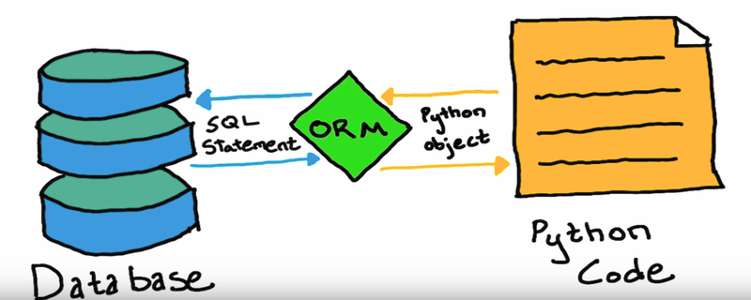
The Database Bridge (SQLAlchemy & ORMs)
The Problem: Writing raw SQL strings in Python (e.g., "SELECT * FROM crops WHERE yield > 100") is prone to errors, hard to debug, and vulnerable to security risks like SQL injection.
The Solution: Object-Relational Mapping (ORM).
Concept: An ORM like SQLAlchemy maps database tables to Python Classes. Instead of writing SQL, you interact with standard Python objects.
Benefit: Your code becomes "Database Agnostic"—you can switch from SQLite to PostgreSQL or MySQL without changing your core logic.

Slide 2
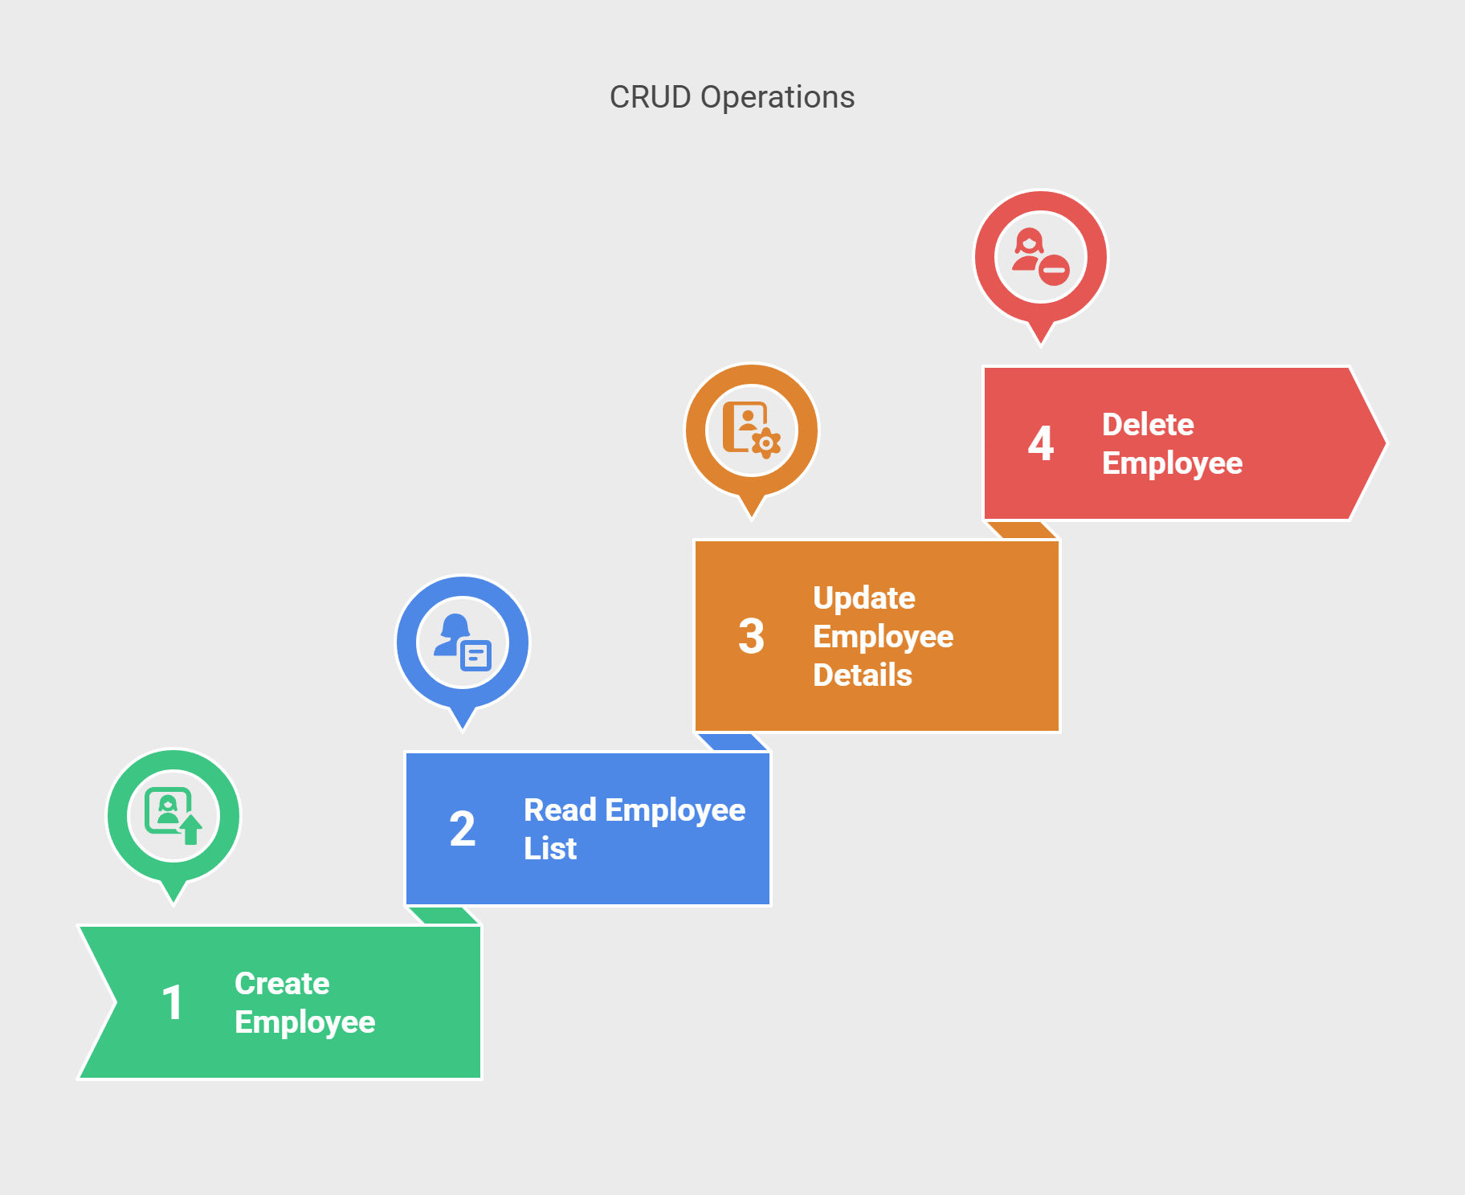
The Lifecycle of Data (CRUD Operations)
Definition: CRUD represents the four essential functions of any persistent storage system:
Create: Adding new data (e.g., registering a new farm in the database).
Read: Retrieving information (e.g., querying last year's rainfall stats).
Update: Modifying existing records (e.g., updating a patient's health status).
Delete: Removing records (e.g., clearing temporary test data).
Workflow: We use a "Session" to manage these transactions, ensuring that either the whole operation succeeds or none of it does (Atomicity).

Slide 3
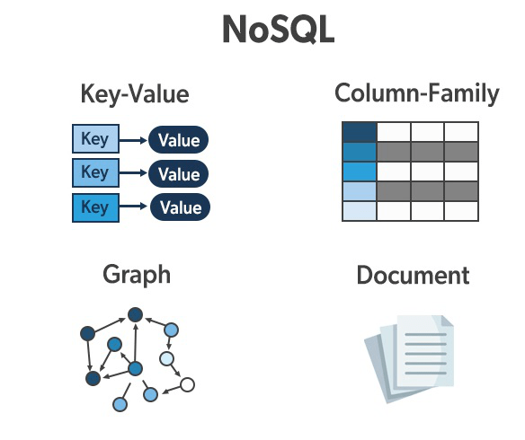
NoSQL – Handling the Unstructured
Beyond Tables: SQL is "Relational" and uses strict schemas. NoSQL (Not Only SQL) is designed for data that doesn't fit neatly into rows and columns.
Document Stores (MongoDB): Instead of tables, data is stored in JSON-like documents.
Use Case: Perfect for social media feeds, sensor logs with varying fields, or real-time application data where the structure changes frequently.

